Slide 1
Ambia True Wireless Earphones
TLL511361

Slide 2
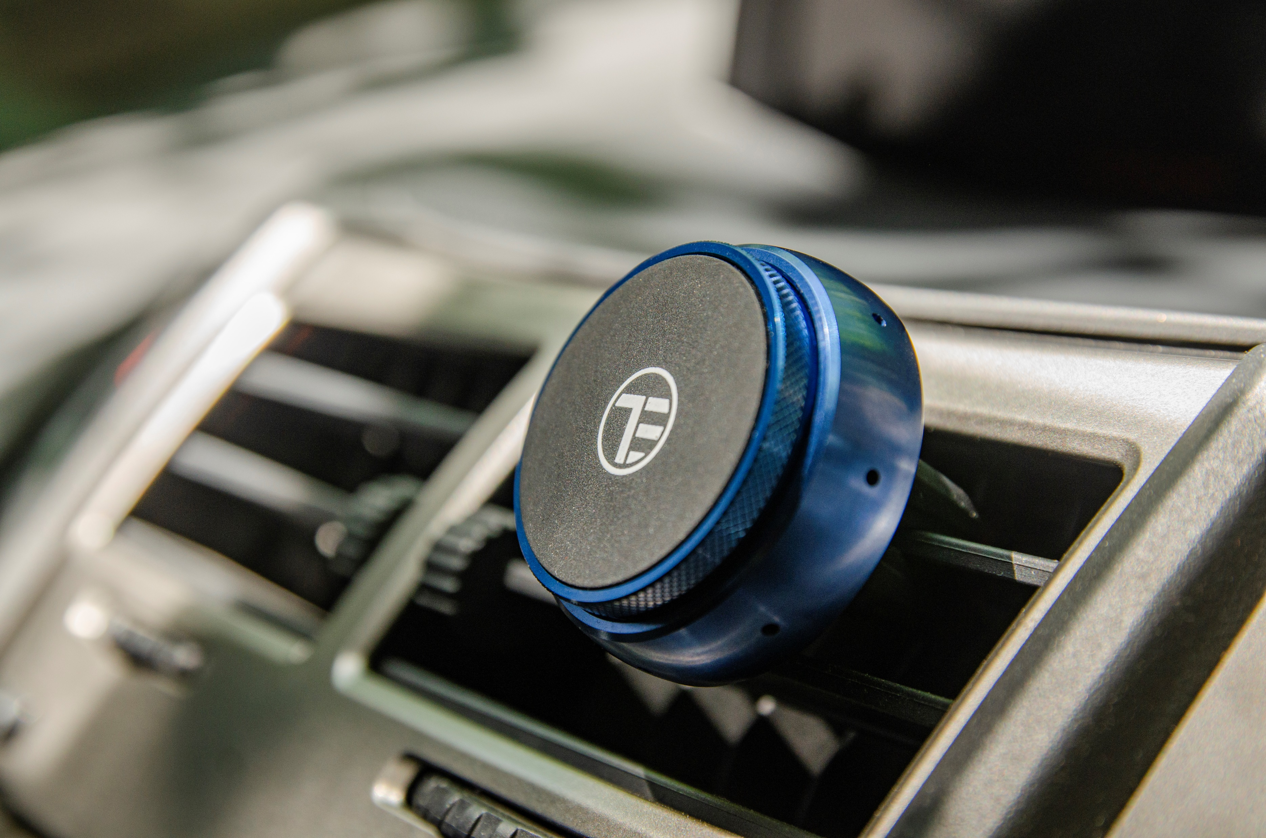
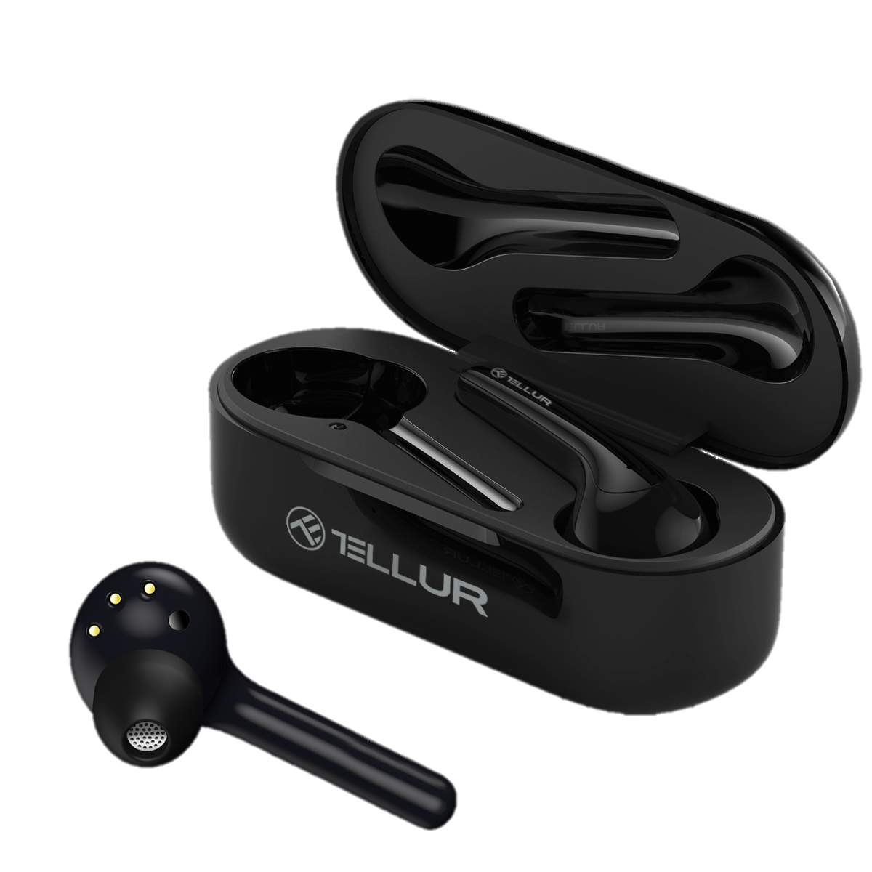

Slide 3
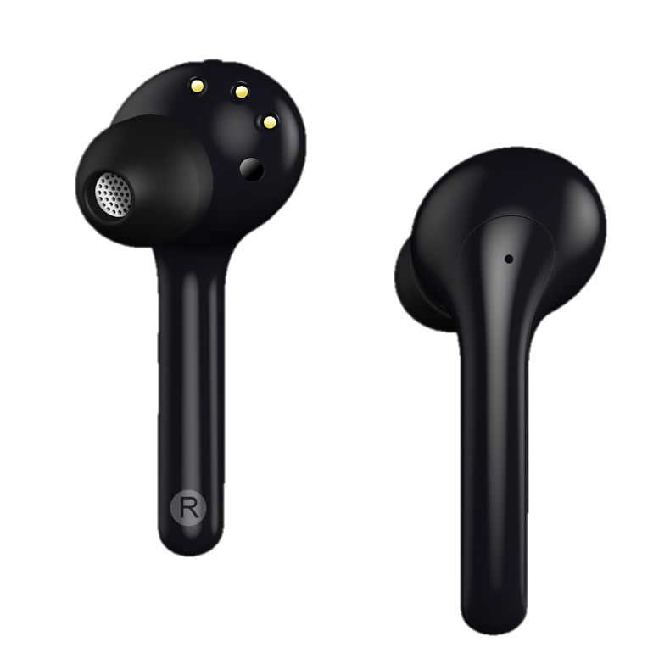
Ambia True Wireless Earphones
Tune your senses
Intelligent control. Voice commands. Powerful sound.
Characteristics:
Infrared sensors detect when you wear the earphones and automatically pause and resume playback
Four MEMS high-performance microphones with ENC technology efficiently reduce environmental noise for clearer hands-free calls
Voice control for music and calls
Double talk time by using one earbud at a time

Slide 4
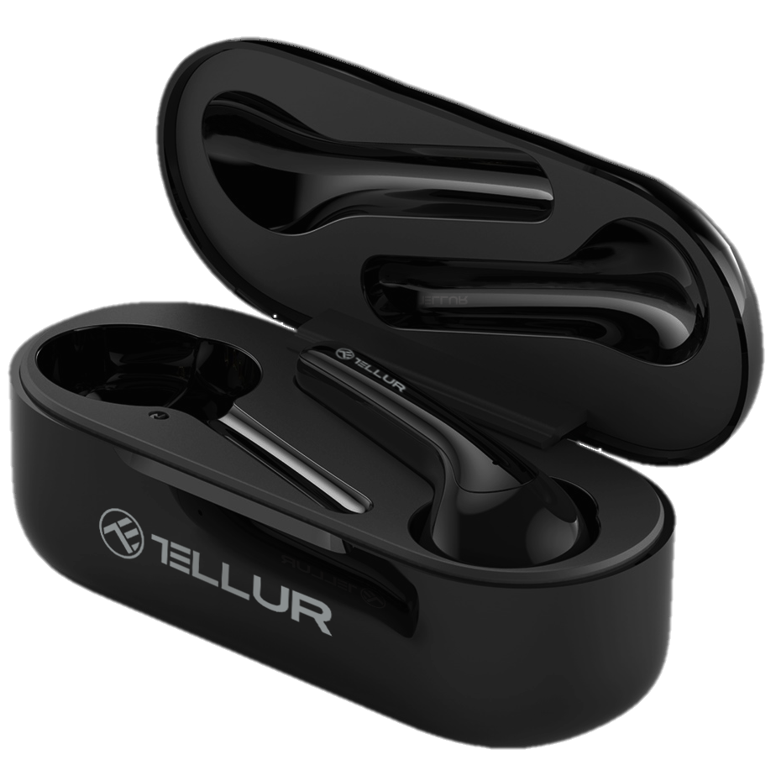
Ambia True Wireless Earphones
Tune your senses
Intelligent control. Voice commands. Powerful sound.
Tune your senses with Ambia - the new true wireless stereo earphones with a rich, deep bass, crystal-clear high notes and sophisticated technologies.
Ambia reconnects automatically with your device by simply opening the charging case.
Smart sensors automatically pause music when you remove the earphones from your ear and resume playback when you put them back on.
Vocal (Google/Siri) and tap control for music and calls
Intelligent Switch function and independent connection for each earbud

Slide 5
Ambia True Wireless Earphones
Tune your senses
Intelligent control. Voice commands. Powerful sound.
Tap control
When listening to music, double tap the right earphone to pause and resume playback;
Double tap any earphone to answer an incoming call and to hang up;
Double tap the left earphone to awake your voice assistant.

Slide 6
Ambia True Wireless Earphones
Tune your senses
Intelligent control. Voice commands. Powerful sound.
Smart calls
Ambia keeps your hands-free calls clear with four MEMS high-performance microphones with Environmental Noise Cancelling technology.
While talking hands-free, use just one of your earbuds to double your talk time. If one earbud is running low on battery, the intelligent switch kicks in and automatically connects the other earbud to your smartphone to keep the conversation going.

Slide 7
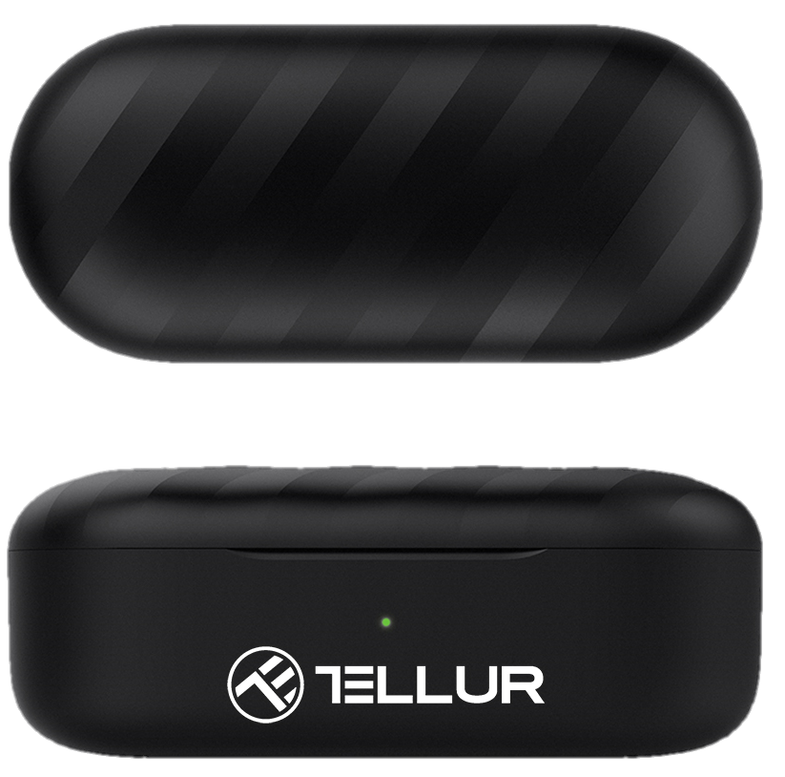
Technical specs
Bluetooth version: | 5.0+EDR, BLE
Wireless range: | 10m
Audio type: | True Wireless Stereo
Supported profiles: | HSP, HFP, A2DP, AVRCP
ENC technology: | Yes, 4-microphone call technology
Audio codecs supported: | SBC, AAC
Speaker
Size: | 6.0mm
Frequency response: | 20Hz - 20KHz
Impedance: | 16Ω
Sensitivity: | 103dB (3dB) @ 1 KHz,126mV
Rated power: | 3mW
Microphone
Type: | 4 x MEMS
Sensitivity: | 42dB ±3dB
SNR: | 60dB
THD: | less than 1% 94dB SPL @1kHz
Impedance: | 200Ω
Sweat and water resistant: | IPX4

Slide 8
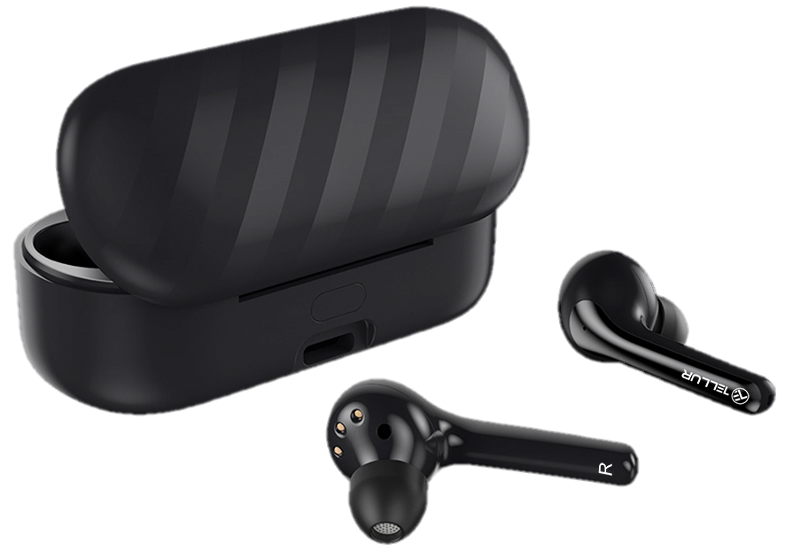
Features: | Voice commands, Wearing detection, Tap control, Intelligent switch, Automatic connection
Music play time: | Up to 3.5 hours and up to 25 hours including charging case
Standby time: | Up to 120 hours
Charge time: | Approx 2 hours
Battery capacity: | 500mAh/3.7V (charging box)
 | 30mAh /3.7V (earphones)
Charging plug: | Type-C
Dimensions: | 43 x 24.5 x 18 mm
Charging case dimensions: | 72.6 x 32.6 x 28 mm
Weight earphone: | 5g
Weight charging case: | 38g
Color: | Black
Package includes: | 1 x Ambia True Wireless Earphones 1 x Charging case 1 x USB to Type-C cable 3 x Set of ear tips (S,M,L) 1 x Manual
Operating temperature: | -15°C to 45°C
Product Code: | TLL511361

Slide 9
THANK YOU!
For more products, please visit www.tellur.com

